Slide 1
Welcome to the experiment, and thank you for agreeing to take part in this study.
This task examines your visual search performance in varying reward conditions. On each trial you will see a collection of L shapes, with a single T positioned somewhere among them. Your task is to search for this “target letter” ‘T’.
Once you have found the ‘T’, you need to respond to the direction in which it is rotated, either left or right.
If the T is rotated to the left, press the C key
If the T is rotated to the right, press the N key
Press the space bar for more instructions

Slide 2
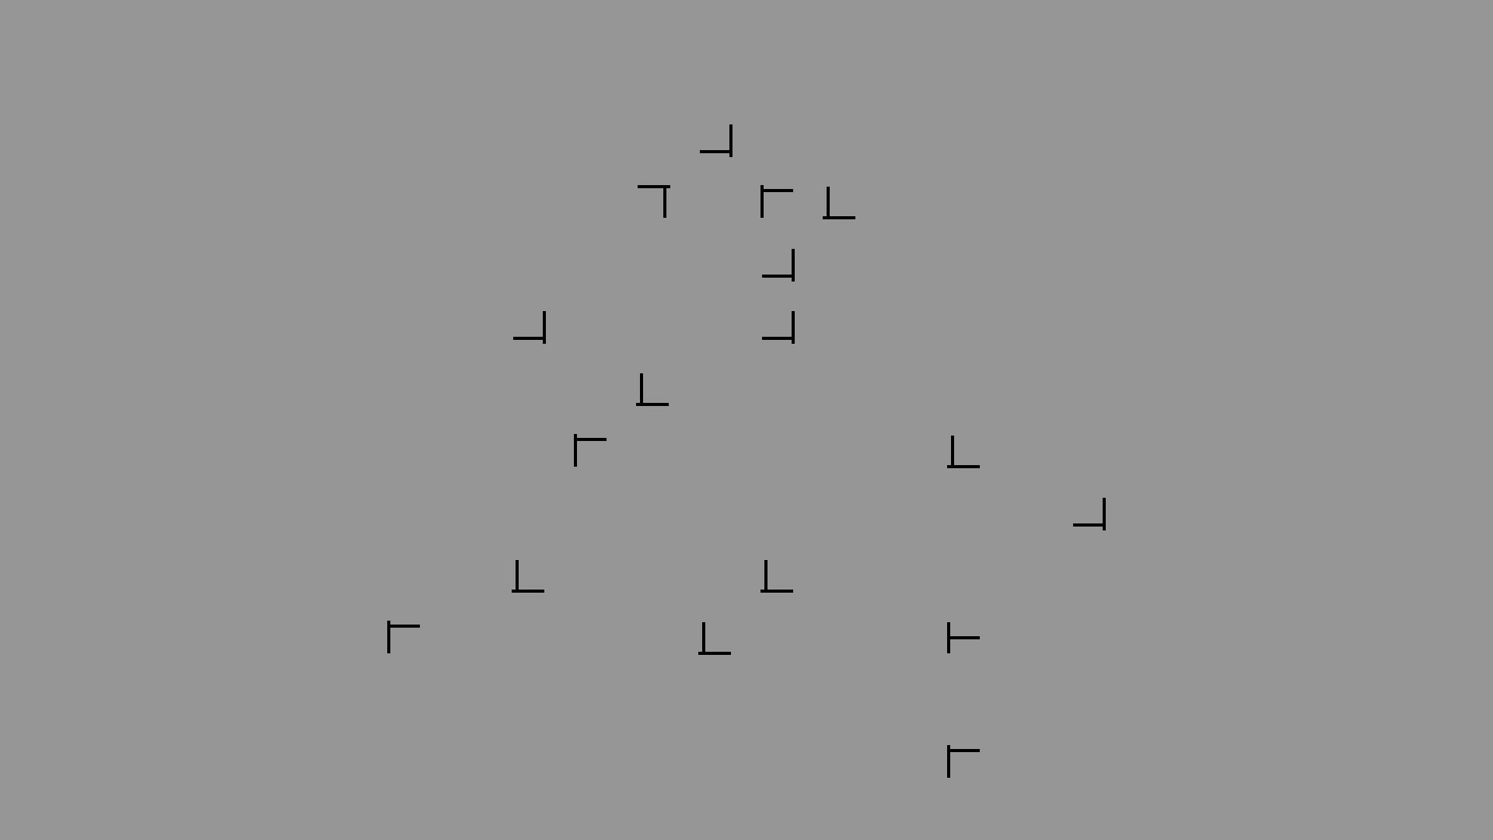
This is an example display. The target is rotated to the left, so here you would press the C key.
Press the space bar for more instructions

Slide 3
If you respond with the correct key, the response time will be displayed along with the number of points gained. Reaction times below 2000ms (2 secs) will earn you a points reward.
If the response exceeds 2000ms, then no points will be scored.
If an inaccurate response is made then 10,000 points will be deducted. Try to avoid this!
Your score will never go below 0.
Note: Your score will earn you the final prize.​
​
Try to get as high a score as possible. The three people with the highest score will win a £20 Amazon voucher!
Press the space bar for more instructions

Slide 4
This experiment will use two reward conditions.
On some trials you will receive a BONUS “10x” reward for fast responses.
On these trials the score will be: (2000 - reaction time)*10
On the other trials you will not receive a bonus.
On these trials the score will be: (2000 - reaction time)
Before each trial, some text will tell you whether it is a “10x BONUS trial!” or whether it is simply a “Normal trial” (no bonus).
Press the space bar for more instructions

Slide 5
This experiment will use two reward conditions.
On some trials you will receive a BONUS “10x” reward for fast responses.
On these trials the score will be: (2000 - reaction time)*10
On the other trials you will not receive a bonus.
On these trials the score will be: (2000 - reaction time)
Press the space bar for more instructions

Slide 6
You will be given regular short rest-breaks during the task.
Please ask the experimenter if you have any questions.
When you are ready to start, place your index fingers on the C and N keys. The experimenter will then start the task.
Please tell the experimenter when you are ready to start

Slide 7
The experiment is complete!
Thank you for taking part in this experiment. The aim of this study is to examine how the reward affects the speed at which you can locate a target, and whether you are aware of repeated configurations.
Your data will remain confidential throughout, and will be stored anonymously at all times and cannot be traced back to you. Please note that due to the anonymous nature of the data storage, we are unable to delete individual data in the future.
If you are interested to hear more about this research, please contact the lead investigator Postgraduate Student Wen Fan (w.fan2@lancaster.ac.uk) or Dr Tom Beesley (t.beesley@lancaster.ac.uk)
Thank you once again. Please see the experimenter.

Slide 8
INCORRECT RESPONSE

Slide 9
TIMEOUT – TOO SLOW

Slide 10
Rest break
Trials will start automatically in 30 seconds

